Slide 1



@edCDCS
DATA
Science
in the Wild
DCODE Winter School
27 January 2023
Notes:
MT

Slide 2



Overview
Introductions
Information & discussion
Review of Python basics
Break
Hands-on data cleaning & analysis
www.cdcs.ed.ac.uk

Slide 3
Discussion
1. How do you define “data”? What does a “dataset” look like in your field?
2. Describe how you have used (or how you might use) data in your work.
3. Where could you find data? How might you collect it?
www.cdcs.ed.ac.uk

Slide 4

Storing & Cleaning Data
Excel, .csv, .json, .txt., .jpeg, .png, etc.
Data cleaning standardizes a dataset for a specific purpose
Restructuring, revising, checking, proofreading, editing, deleting from, and adding to the data
One of the most important (and time-consuming!) steps in research
www.cdcs.ed.ac.uk
Notes:
LO

Slide 5

Data Ethics
Where did the data come from?
Who gathered the data? How, and why?
Have potential biases been accounted for?
Demographic/population
Historic
Observer
Are there any risks associated with the data?
Is the dataset complete?
Was ethics permission obtained?
www.cdcs.ed.ac.uk

Slide 6
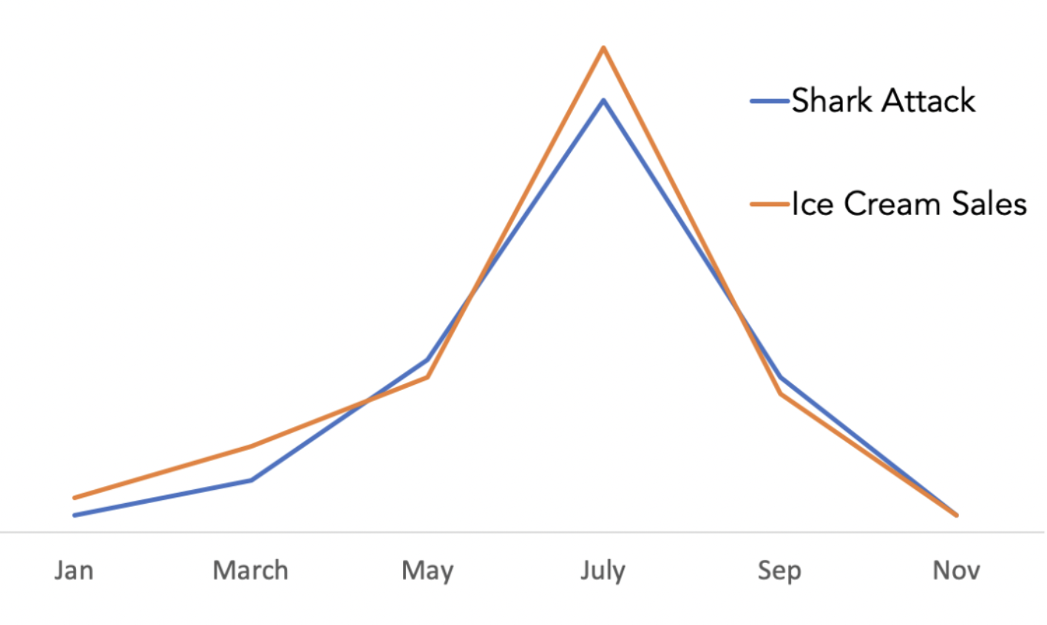
www.cdcs.ed.ac.uk

Slide 7

Data Ethics In Practice
A PhD student is conducting thesis research on gender representation in eighteenth-century Scottish literature. She gathered a dataset of authors’ names from Google Books. Then, she used a Python package to determine the authors’ genders. The package was trained on a dataset of popular English-language first names identified as either “feminine” or “masculine.”
Discuss the researcher’s dataset and methods. What problems can you foresee? What solutions might the researcher consider?
www.cdcs.ed.ac.uk

Slide 8

Data Ethics In Practice
A team of developers is training a voice recognition model for a smartphone. They create a dataset of TED Talk recordings and receive permission to use the data for training the model. After training the voice recognition model, the developers perform testing. They are surprised to find that the model struggles to detect voices of higher pitch and lower volume.
Discuss why the VR model performs better when detecting certain voices. What are the potential consequences of implementing this VR model? And, how could the developers improve their results?
www.cdcs.ed.ac.uk

Slide 9

Basic Python Terms
Input and output: a user enters an input and Python responds with an output
Error: an output that highlights an incorrect input
print() statements
Operators: plus (+), minus (-), multiply (*), divide (/), floor division (//)
Variables: saving a value under another value (x=7; x is the variable and equals 7; month = “January”)
Comparisons: x equals y (x==y), x does not equal y (x != y)
Booleans: input resulting in True/False outputs (input: 5 < 7 output: True )
Conditionals: if/then (if month not “January”: // print (“No, it’s not January.”)

Slide 10


Some Pythonic Data Structures
Data type:
integer (whole number: 94, -94)
float (number with a decimal point: 100.6, 100.0)
string (often textual data: ‘coffee’, ‘I would like a cup of coffee’)
List: hold several values; can be stored as a variable
cities = [‘New York’, ‘London’, ‘Tokyo’, ’Berlin’]
Dictionary: stores information as key:value pairs
city_dict={‘New York’:’USA’, ‘London’:’UK’, ‘Tokyo’:’Japan’, ‘Berlin’:’Germany’}
Dataframe: like a table or spreadsheet; can store several types of data

